Slide 1

Analysis of Online Advertising Performance Dataset
Submitted By:
Sharon Blessy J V
Indian Institute Of Information Technology Tiruchirappalli

Slide 2

CONTENTS OF THE DATASET:
The dataset provides data regarding the online advertising performance of a company from April 1, 2020, to June 30, 2020.
SIZE OF THE DATASET:
The dataset provides contains 12 columns and 15409 rows.
OUTLIERS OF THE DATASET:
The 413 data items in the placement column.

Slide 3

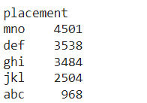
More Details ….
Company X is divided into camp 1, 2 and 3.
User engagement is classified into low, medium and high.
The size of ads used in the company advertisement are (160 x 600), (240 x 400), (300 x 250), (468 x 60), (580 x 400), (670 x 90), (728 x 90) and (800 x 250).
The publisher spaces where these are advertised are abc, def, ghi, jkl and mno.

Slide 4
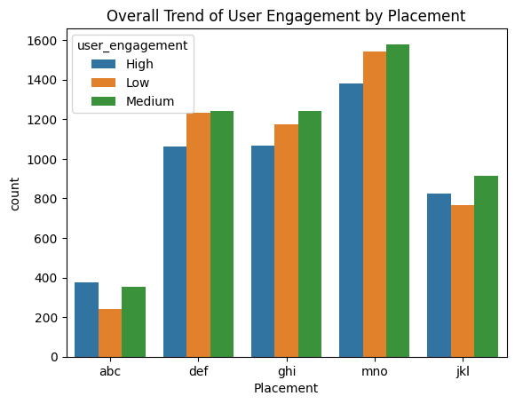
Overall Trend of User Engagement by Placement:
Majority of the ads are published in mno and the least is in abc.

Slide 5
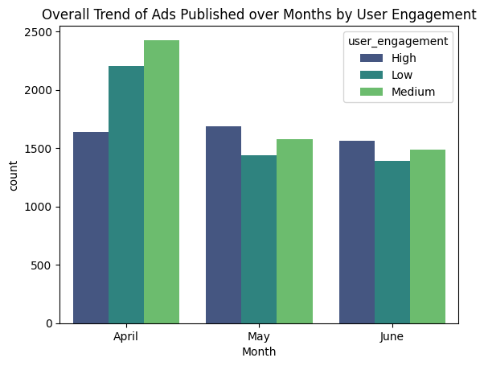
Overall Trend of Ads Published over Months by User Engagement:
Majority of the ads were published in the month of April.

Slide 6

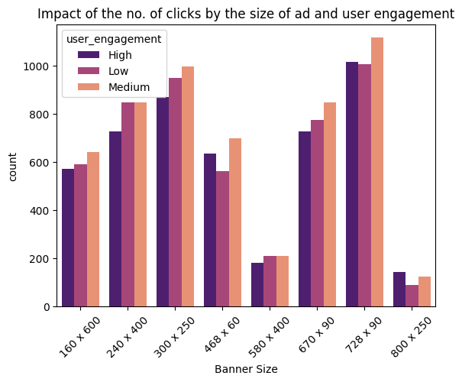
Impact of the no. of clicks by the size of ad and user engagement:
Majority of the ads clicked are of the size (728 x 90).
The least clicked ads are of the size (800 x 250).

Slide 7
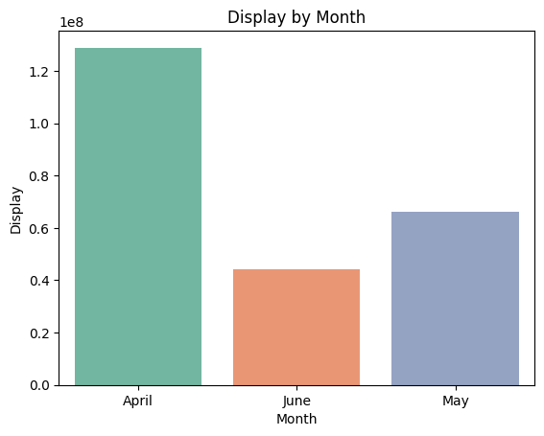
Distribution of displays over the month:
Majority of the displays were in the month of April and the
least in the month of June

Slide 8
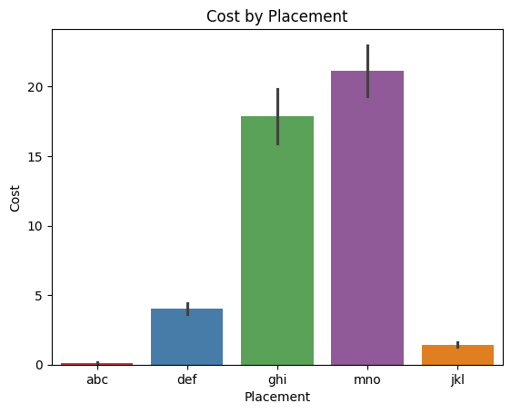
Distribution of cost by placement:
Cost of serving ads in mno is the most costliest while abc is the cheapest.

Slide 9
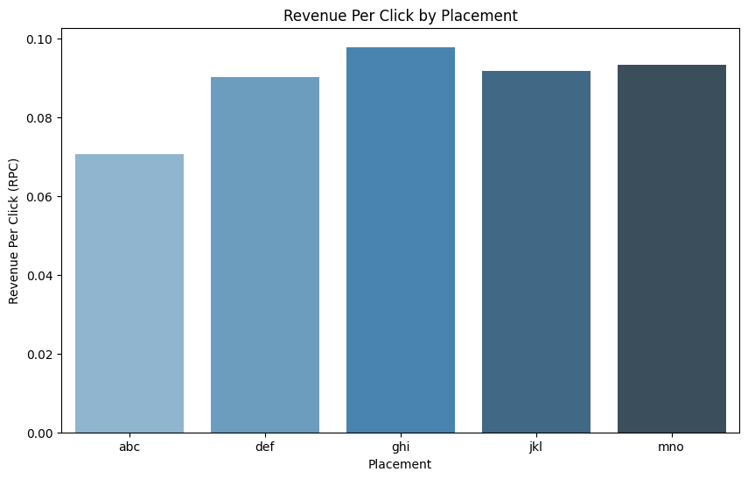
Revenue Per Click By Placement:
Revenue per click of ghi is the highest and abc is the least.

